Slide 1



Fast 5 Webinar: Transforming Safety Report Distribution
Notes:
Objective of the Fast 5:
Provide a “teaser” highlighting the most critical values and factors of the new product (WCG SafetyPortal).
Target Audience for Fast 5:
External – provide a teaser for interested parties on the problem and solution and where to go to learn more (info@wcg)
External – can be used as a “calling card” for WCG SafetyPortal”
Internal: should align with product key messages and documentation
Internal – Internal product awareness
Why is Safety reporting Challenging
What is the impact on industry and clinical trial sites
WCG solution
Value to industry
Feedback:
Steven
Kristy
Joe
Brian
Diane
Cindy
Lauren

Slide 2











































WCG At a Glance
About Us
1,000+ Employees
56 Physicians – 18 Reg Attorneys
12,000 Clinical Trials per Year
40,000 US-based Research Sites
160,000 Global Research Sites
300,000 Global Users
2,800 Academic Medical Centers & Institutions
Every Major Pharma & CRO
Biopharmaceutical Companies
Institutions
Locations
Princeton, NJ (Corporate)
Frankfurt, Germany
Munich, Germany
Hamilton, NJ
Philadelphia, PA
Cary, NC
Tacoma, WA
New York, NY
Boston, MA
Cambridge, MA
Newton, MA
Washington, DC
San Diego, CA
Kansas City, KS
Minneapolis, MN
Vancouver, BC, Canada
Tokyo, Japan
London, UK
Guadalajara, Mexico
Chennai, India
Moscow, Russia*
Contract Research Organizations
Notes:
Note: Same talking points used in Fast 5 for site feasibility

Slide 3
What is Today’s Challenge with Safety Report Distribution?
Clinical trials are complex
Multiple countries, global and local teams
Lack of Global Harmonization
Regulatory environment
Lack of Precision Distribution
No standard process, process fragmentation
Lack of Transparency
Multiple partners
Fear of regulatory persecutions
Quality oversight
Study vs compound level
Combination and multicompound studies
No clear country rules
Multiple system integrations
Accountability
Marketing status
3
Notes:
Talking Points:
What is Safety Report Distribution?
Process used to provide Investigational sites with the safety information they need to effectively manage the patients on the clinical trial
Clinical Trials are complex
xxxx
Lack of Global Harmonization
xxx
Lack of precision distribution
xxx
Lack of Transparency
xxx
From Sell Sheet:
WCG offers the only global safety reporting solution that has been demonstrated to increase compliance and improve patient safety, while reducing cost and streamlining operations.
Safety Portal is the only technology-enabled solution to measurably improve the safety distribution process. Leveraging global expertise and proprietary technology, Safety Portal addresses the three main sources of sponsor frustration:
• Lack of harmonization among global reporting rules, which are complicated and vary by country
• Difficulty determining causality
• Fear of non-compliance and regulatory repercussion
From Webinar:
So before we try to look at solutions, it is important to understand the problem.
So why is safety reporting a problem – in pondering this, and wondering why this seems to be getting to be a bigger and bigger issue every year, I cant help but think we are a victim of our own success when it comes to clinical and drug development and the industry's ability to capture large amounts of data.
First – We are now able to run very large clinical trials which is magnifying some of the underlying issues that drive the problems we face
This is not a surprise for anyone involved in running trails, but it is increasing difficult to ensure the consistency and standard resulting in fragmentation of how safety reporting is managed – often cited for inconsistencies in maintaining a process
The regulations around safety reporting are unclear and the rules vary around the world
We have countries where Investigators require all SUSARs vs those that do not require any such as Australia yet they are participating in the same global trial looking to recruit the same type of patients
Again adding to the complexity of a clinical trail and the regulatory environment is the IMP or IP status
Clinical trials typically involve multiple compounds in a trial adding to the complexity of just assessing cases received and compound the complexity in how expedited reports are managed
The marketing status of compounds can also vary around the world again making the reporting requirements difficult
All of these issue attribute to the lack of global harmonization in how safety reporting is managed where there is no clear standards developing on how safety reporting to Investigators and ethics be managed around the world.
The impact to outs sites is over distribution - just send them everything and sites are struggling to filter out the information that is meaningful to them.
Where even though the industry is making progress and implementing technology to collect, analyze and process data, improvements in how sites can review ad have access to the right information when they need it is still lagging.

Slide 4
What is the impact on the Industry & Study Sites?
Excessive consumption of resources
Difficult to provide evidence of compliance
Less time to focus on the patient
Focus on administration vs Safety
Busted Budgets
Receive the same information multiple times (or not at all)
Relevant Safety Information is being hidden by Over-Distribution
Distracting valuable resources and focus away from the patient
4
Notes:
Talking Points:
Creating an environment where sites just cannot see the “forest through the trees”
Current reporting processes focus on compliance checks on how information was sent as opposed to the relevance of the information sent
xxxx
Consumes valuable resources need to manage and oversee
Estimate site hours
Hrs needed t process by a CRO
Its expensive and wasteful
Industry average xxx
Extremely difficult to know you have complied with the regulations as the rules are vague and often reporting is managed at a study level so each team decides what is sent to a site often with the same compound
Most sites participate on average 2 or 3 studies
Multiple interpretations of the same HA requirements
Sites receive the same information different ways (mail/fax/email) and at different times making it very difficult for them to know what is “right” and also have to deal with the secondary activities such as informing there IRBs IRBs other site staff and filing in there TMF, further adding to the resource burden
Lastly, this results is distracting them for there core value activities which is to focus on the patient and the clinical trial
Notes:
Grey box Order – from lower level priority to higher level
Time/cost/quality (pt safety)
Are there metrics available to speak to these points
Can make terminology in boxes lass wordy
Lack of global harmonization
Unclear rules
Is there a global rule that all countries comply with
Accountability
Who is accountable for defining or interpreting what local law is
Consistency and application
How do you keep everyone trained and informed
How do you apply these rules or decisions once made across all countries and sites
Causes of overdistribition
Fragmented process
Is there a global rule that all countries comply with
Multiple interpretations of local law
Often would send everything “just in case”
Study level distribution
We work with large number of study teams, and partners and often they took it upon themselves to provides sites with safety information
Our sites on average are doing 3-4 studies often with the same compounds
Resources
Sites and IRBs
Sorting out the multiple documents and why there are discrepancies
IRB submissions, communicating with other site staff, archiving and tracking
Study Teams
Expending resources to ensure sites and IRB got the necessary information
Insourced and outsourced studies
Monitors
Tracking, reconciliation and archiving
Managing gaps manually
Quality Oversight
Accountabilities
Who is accountable to ensure sites and IRB/IEC are receiving the right information
Fragmented process
++ resources need to oversee a process that is managed multiple ways
Addressing gaps
Evidence of compliance

Slide 5







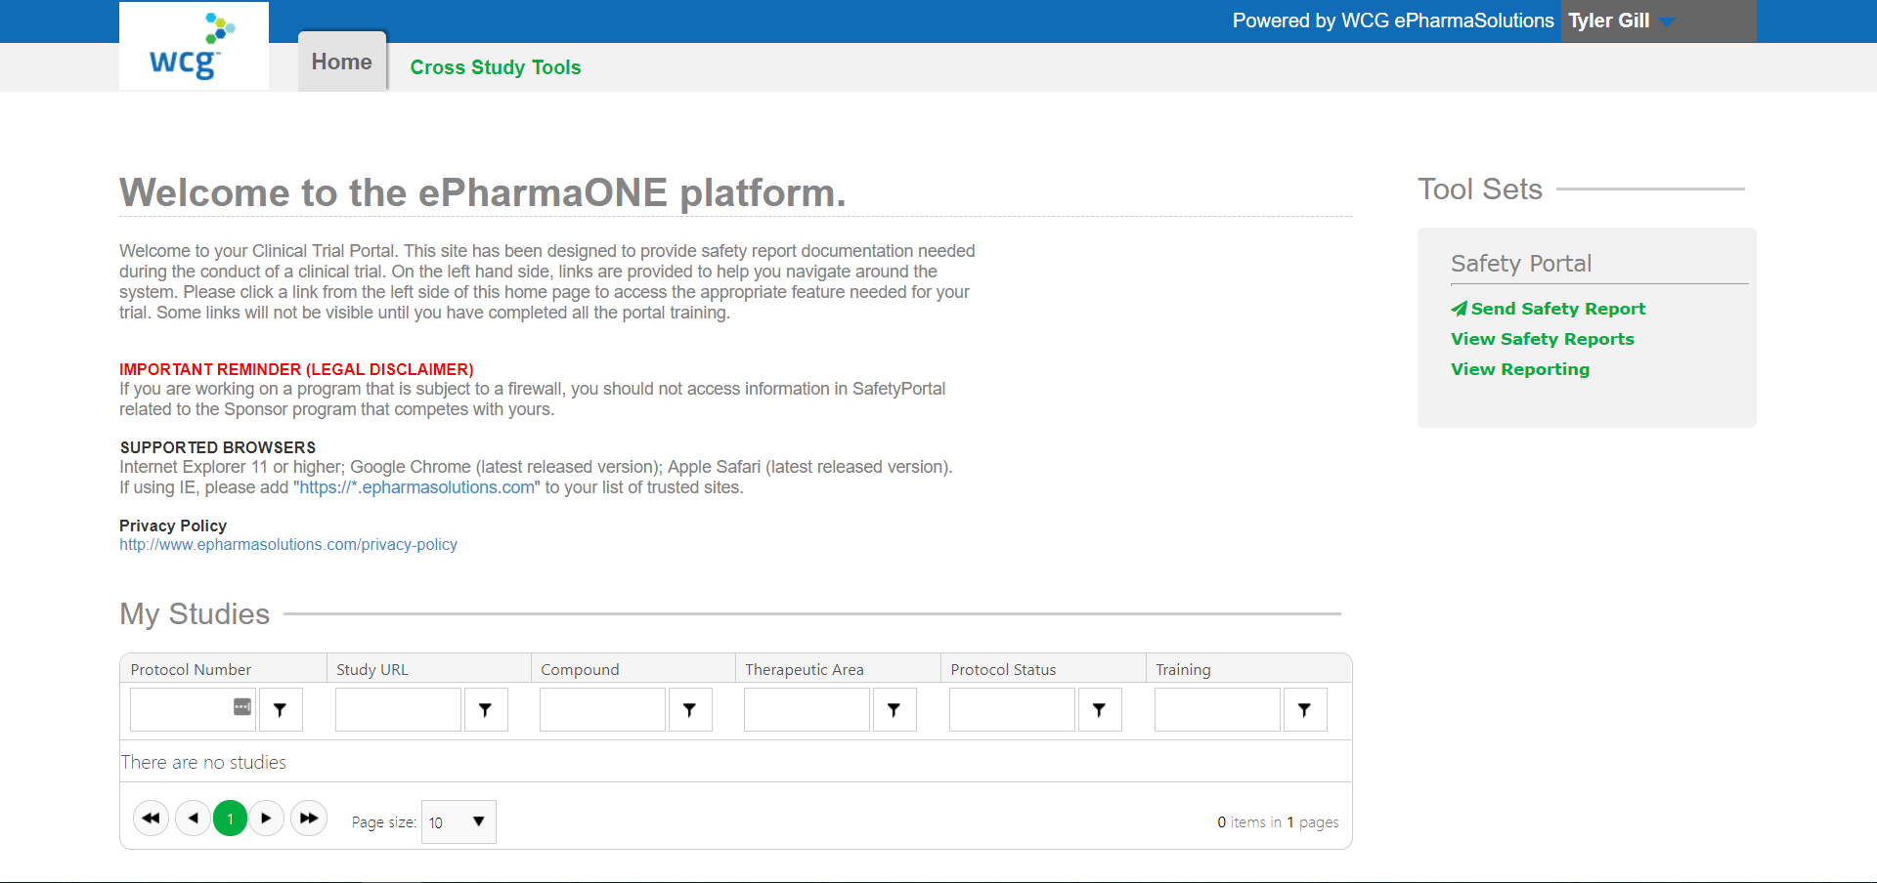
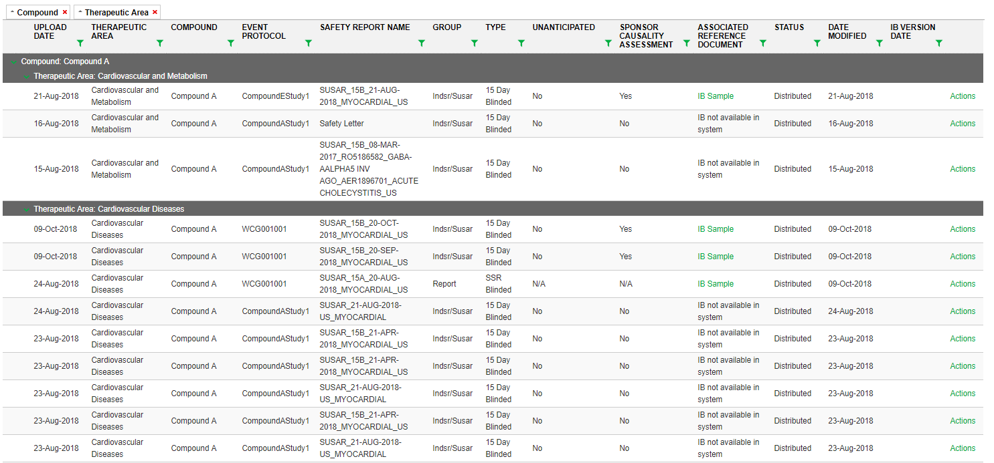
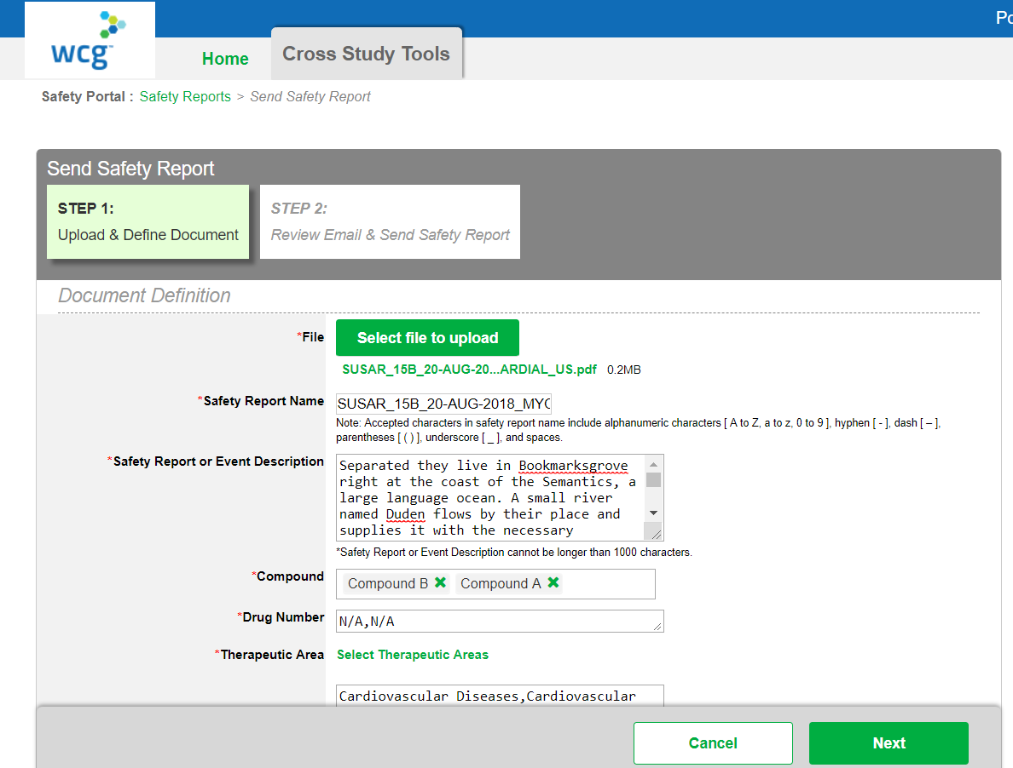
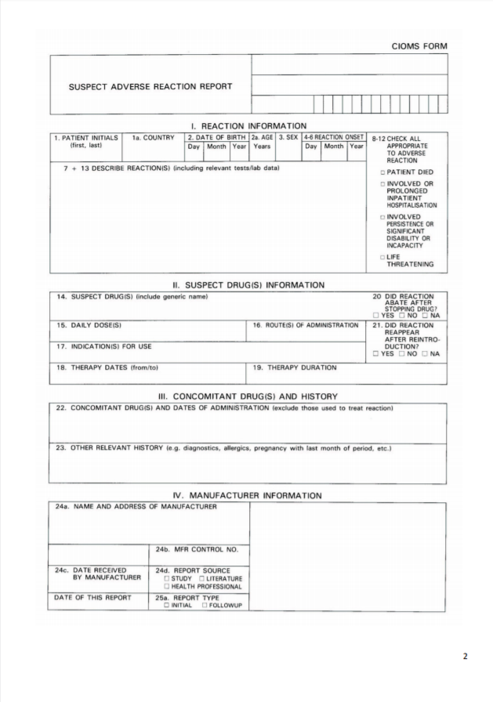
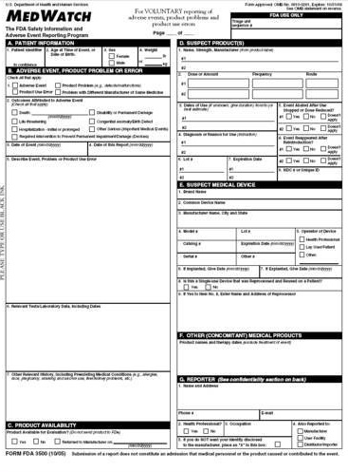
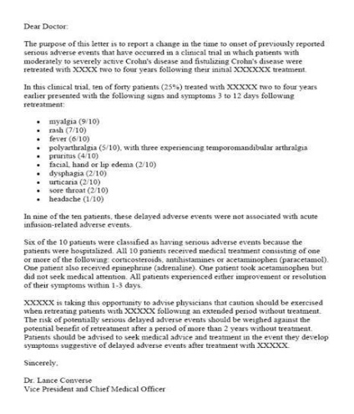
What is the WCG Solution for Safety Report Distribution?
Precision Safety Report Distribution
Safety Reference Model
Sites and Ethics Experience
Document Upload with QC
Targeted Distribution Algorithms
Blinded and Unblinded
Distribution & Acknowledgement Reporting
Dashboards
Country Rules for 110+ countries
Metrics and Analytics
Oversight and Reporting
Regulatory Intelligence
Study Milestones
“Gap Pack” distribution
Archiving at study and site closure
Safety report repository
Helpdesk
WCG SafetyPortal eliminates over distribution enabling study teams and sites to focus on what they do best which is running clinical trials
Notes:
Talking Points:
At WCG, patient safety is at is core as part of its scientific and regulatory safety function and have a ………
Launch Plan –
SafetyPortal Solution
SafetyPortal is the next generation of what is currently known as the Safety Letter Distribution (SLD) system. It is an automated precision technology solution that allows safety related reports to be disseminated to investigative sites and IRB/IEC members globally, in real time, with the click of a button.
From SafetyPortal User guides:
SafetyPortal is a solution developed by WCG ePharmaSolutions that manages safety report distribution. SafetyPortal enhances collaboration in sharing safety information between sponsors, vendors (including Clinical Research Organizations (CROs)), investigative site staff, and IRB/IECs. Investigators and site staff, Institutional Review Boards (IRBs), and Independent Ethics Committees (IECs) are made aware of new safety distributions through automated email notifications. The automated email notifications contain relevant details of safety reports according to the pre-defined notification email templates. Safety reports are available to investigators/sites, CROs, and IRB/IECs for the sponsor’s clinical trials via SafetyPortal. SafetyPortal comprises:
An integrated learning management system that assigns required training to system users, invites users to take training, and gates new users’ access until training is completed
A repository into which safety reports are loaded and stored. Users must have the Document Uploader role to add safety reports to the SafetyPortal. These users are typically members of a sponsor’s Safety/Pharmacovigilance/Regulatory Operations unit.
An interface that allows users to electronically upload, distribute, access, and download safety reports. The application manages each user’s permissions to perform these actions based on the system role granted to the user, whether an IEC or IRB will accept safety reports directly from the application or sponsor, and properties belonging to each report stored in the system.
An audit trail of all distributed safety reports including delivery times and dates, and the corresponding site or IRB/IEC access for each report
From Steven’s slide:
Precision Safety Report Distribution to Sites/ECs driven by CTMS and Argus Safety Data
Safety Reference Model – country alerting rules for over 110 countries powered by regulatory intel
PI and Site level receipt, transmission failure and acknowledgement reports
Blinded, un-blinded distribution and IEC/IRB workflow
Site and Sponsor archive capabilities

Slide 6

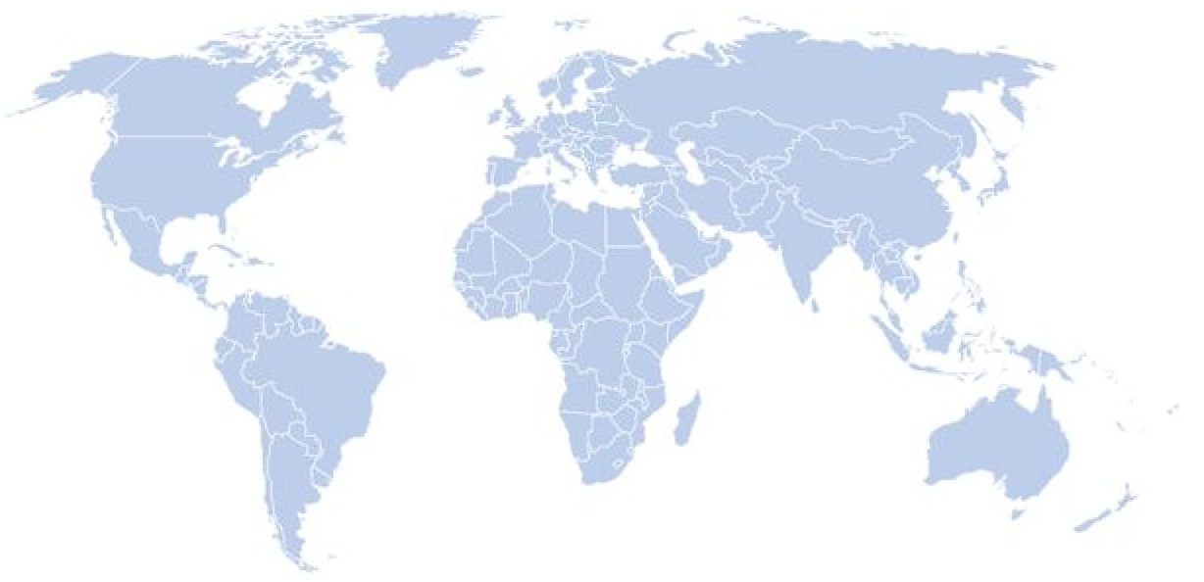


What is the Value for Your Organization?
Precision Distribution
Safety Reference Model
Study start/Site activation
Close down
Dashboard Reporting
Archiving/Central repository
Helpdesk Support
Metrics and Analytics
Global Harmonization
Global Standards
IMP/IP definitions
Consistent application
Precision Distribution
Safety Reference Model application
Regulatory intelligence
Compound Level Distribution
Unburdened Resources
Sites, IRB/IECs
Study Teams & Monitors
Cost containment
Quality Oversight
Process and Procedures
Transparency and Monitoring
Compliance and Inspection Readiness
Driving Global Harmonization in Safety Reporting
6

Slide 7
Questions
Thank you for joining today’s Fast Five webinar!
For more information, please contact info@wcgclinical.com
7
Notes:
References:
SafetyPortal Launch Plan - Version 1.0 July 12, 2018
SafetyPortal User Guide (Celgene)
SafetyPortal Sell sheet
Managing the Unmanageable

